Slide 1
GradLink
Design Sprint
Product Manager: Vanessa Lam
© 2019 Udacity. All rights reserved.

Slide 2
Set the stage
Set the stage for the Design Sprint by framing the problem
© 2019 Udacity. All rights reserved.
Notes:
[ALL PARTICIPATION]

Slide 3

Initial PRD
PRD

Slide 4
Understand
Create a shared understanding of the space, problem, and goals
© 2019 Udacity. All rights reserved.
Notes:
[ALL PARTICIPATION]

Slide 5
How Might We
How might we match students up with roles?
How might we increase awareness of the full product offering?
How might we support users in submitting a job application?
How might we make users feel confident that they are applying for a role correctly?
How might we make learning more assessable to students?
How might we increase employment opportunities for users?
How might we help students gain a realistic understanding of learning and work options?
How might we make users feel confident they have all the information they need?
How might we help users understand the role they are applying for?
How might we increase user job satisfaction?
How might we make career guidance more appealing to students?
How might we protect user information?
How might we promote learning opportunities to students?
How might we support employers needs and expectations?
How might we create a job recommendation system?
How might we make it easier for students to keep track of their applications?
How might we generate more job listings for users?
How might we create a supportive network for students to ask questions?
How might we make it easier for students to find mentors?
How might we assess a students skills?
How might we support students with information about employers?

Slide 6
How Might We
How might we use the data we currently have on users?
How might we make out app appealing to users?
How might we save time for students applying for jobs?
How might we support employers in finding the right candidate?
How might we keep up with changing user preferences?
How might we increase conversion to paid subscriptions?
How might we introduce students to other career paths?
How might we reduce the number of applicants rejected for a role?
How might we catergorise data from self assessments?
How might we help users determine their career goas?
How might we rate a students skills?
How might we evaluate job satisfaction?
How might we gather user feedback?
How might we gather feedback from employees about companies?
How might we increase our visibility amongst students?
How might we improve users hard skills?
How might we improve users soft skills?
How might we increase user application success rate?
How might we foster a comminity network for students to reach out for help?
Team Members:
Yellow = Vanessa
Orange = Olivia
Blue = Bradley
Green = Gerald
Purple = Pepper

Slide 7
Content
Learning
Improvement
How might we help students gain a realistic understanding of learning and work options?
How might we make users feel confident they have all the information they need?
How might we help users understand the role they are applying for?
How might we improve users hard skills?
How might we improve users soft skills?
How might we help students understand their interests and skillset?
How might we support students with information about employers?
How might we introduce students to other career paths?

Slide 8
Algorithm: Job match
Self-assessment
Data
How might we match students up with roles?
How might we assess a students skills?
How might we keep up with changing user preferences?
How might we catergorise data from self assessments?
How might we use the data we currently have on users?
How might we protect user information?
How might we help users determine their career goas?
How might we create a job recommendation system?
How might we rate a students skills?
Save time
How might we make it easier for students to keep track of their applications?
How might we reduce the number of applicants rejected for a role?
How might we save time for students applying for jobs?

Slide 9
Marketing
How might we increase awareness of the full product offering?
How might we make career guidance more appealing to students?
How might we make out app appealing to users?
How might we increase conversion to paid subscriptions?
How might we increase our visibility amongst students?

Slide 10
Channels
Application Support Channels
Partnerships
How might we support users in submitting a job application?
How might we make users feel confident that they are applying for a role correctly?
How might we increase user application success rate?
How might we make learning more assessable to students?
How might we increase employment opportunities for users?
How might we promote learning opportunities to students?
How might we foster a comminity network for students to reach out for help?
How might we create a supportive network for students to ask questions?
How might we generate more job listings for users?
How might we make it easier for students to find mentors?
How might we support employers in finding the right candidate?

Slide 11
Feedback
Student Feedback
Employer Feedback
How might we increase user job satisfaction?
How might we evaluate job satisfaction?
How might we gather user feedback?
How might we support employers needs and expectations?
How might we gather feedback from employees about companies?

Slide 12
Sprint Focus
Focus | Algorithm: Job match
Slide # | Slide 8
I selected this theme because | To create a personalised job recommendation service for students, we will first need to focus on creating a job matching algorithm on student preferences, skills and abilities and match it up with jobs. Implementing this theme can provide a real competitive advantage over traditional job seach engines as it will enhance the customer experience and efficiency of searching and attaining a role.

Slide 13
Define
With an understanding of the problem space, create focus and align on specific outcomes for the Design Sprint
Notes:
[ALL PARTICIPATION]

Slide 14
LinkedIn launches GradLink App to tackle unemployment rates for graduates
GradLink App offers a personalised service to help graduates to find their passion, get their foot in the door and succeed in the workforce.
The world’s largest professional networking platform, LinkedIn, is launching a new app in an effort to tackle unemployment rates. With 19.64 million students currently enrolled in college in the US, and unemployment rates sitting at a staggering rate of 7.2%, the GradLink app aims to match students and graduates with employment opportunities.
GradLink is one of the first apps to provide personalised job recommendations to students based off their skills, preferences and interests. Using it’s innovating algorithm, GradLink acts as a virtual career guide, suggesting career paths, providing information on job opportunities, company insights, and upskill opportunities to ensure students are well equipped to be the best candidate for the role. Breaking down the barrier between employers and employees, the recruitment process aims to be more transparent with employers able to specify what they are looking which is conversely relayed to the employee. Users will also be able to stay up-to-date with the latest jobs available in the market as well as get help from coaches and mentors through the app.
Kickstarting a career is now a little less difficult. With apps like GradLink, students and graduates are given an equal opportunity to succeed in the workforce.

Slide 15
Success Metrics
Set at least two user-centered goals
Identify changes in user behavior will signal success in reaching the goal
Create a metric to measure each signal
 | Goals | Signals | Metrics
Happiness | User is happy to use the app User finds information helpful Users job satisfaction increases User gets a job User gets reward for meeting goals | Leave app rating Leaves feedback on job satisfaction Contributes reviews on product Reward points assigned to user | Time spent on app # of 4+ star reviews App store reviews NPS Average # of reward points
Engagement | Explores career opportunities Create a career plan Mentoring services Searching for new roles Applying for roles | Amount of time on app Amount of time searching for jobs Amount of time on career plan Amount of mentoring services Number of applications submitted | # of visits per user per week Avg # of amendments on career plan# people who sign up for mentor services # of jobs applied/ viewed
Adoption | Recommendation to friends New users | Referral link sent to friends Number of app downloads | # app downloads with referral link # of new users
Retention | Subscription to paid features Users continue to use app | Subscribe to paid version Returning users | Churn rate Subscription renewal rate Daily active users
Task Success | Reduce abandoned profiles Reduce app crashes Increase applicant success rate Increase job satisfaction rates | Completed career plan page App crash feedback Applicant feedback | % of users with completed career plan Avg # of crashes per user High ratings on customer feedback for job satisfaction

Slide 16
Sketch
Generate tons of ideas, then narrow them down to two in depth solution sketches
Notes:
[ALL PARTICIPATION]

Slide 17
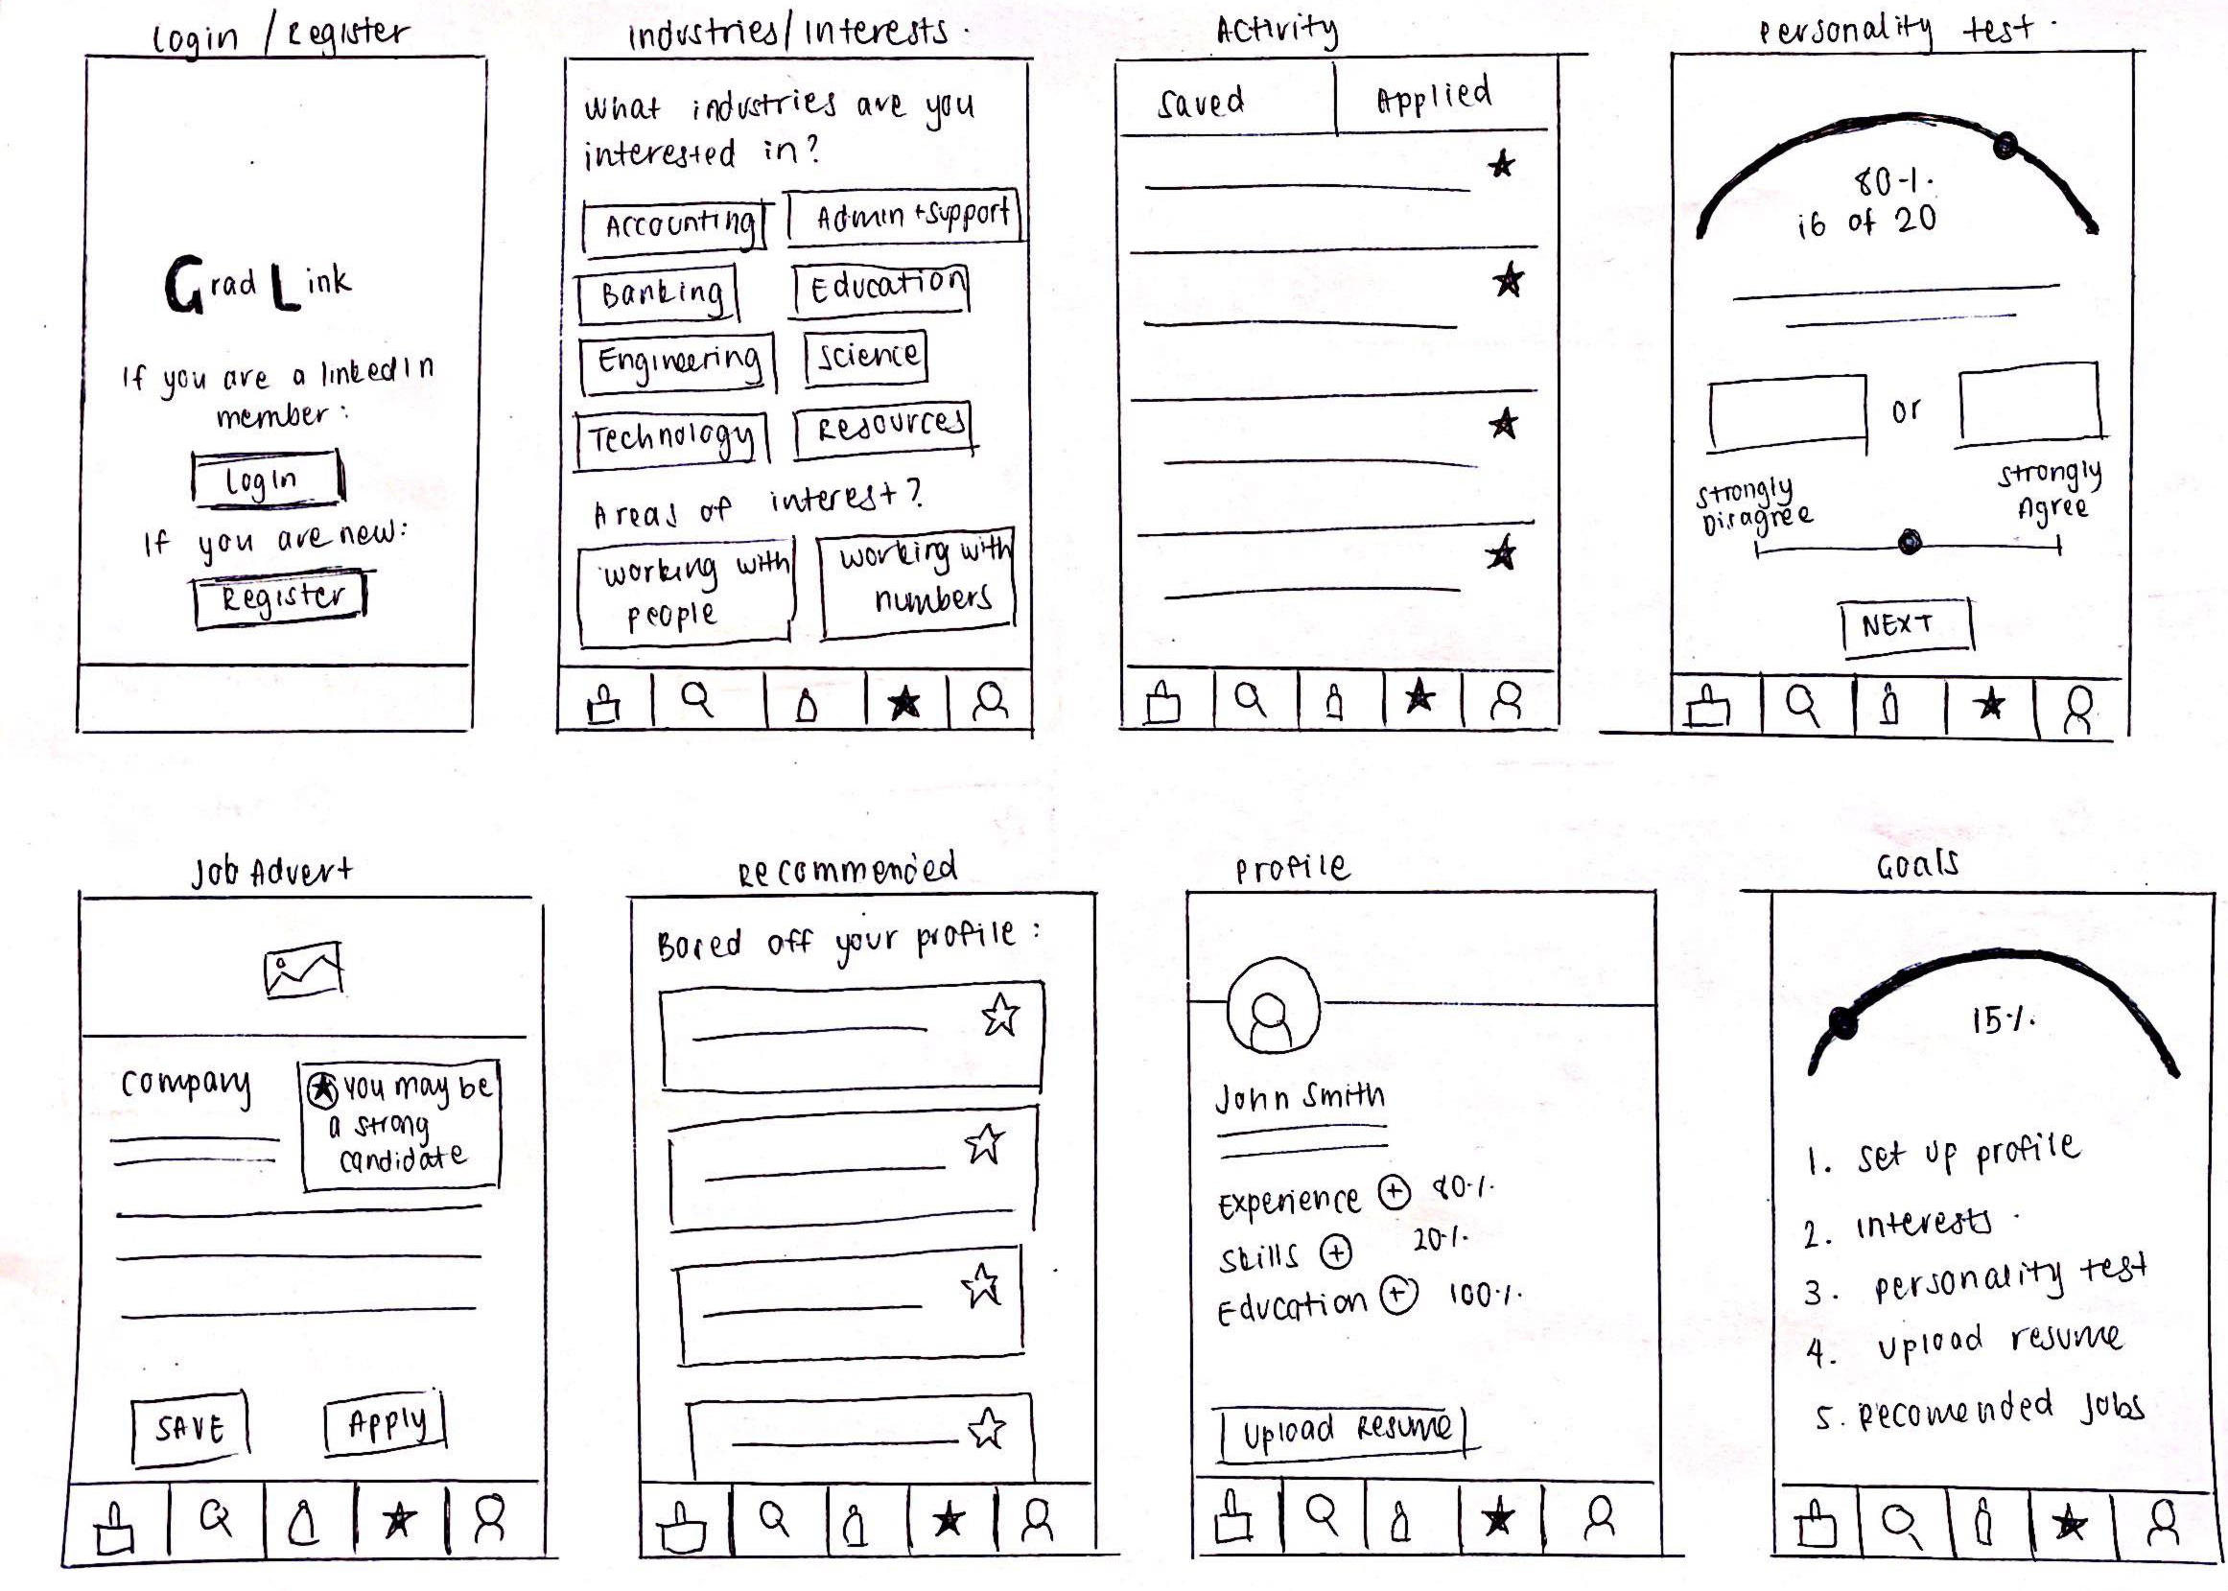
8 Sketches
Photo of your 8 sketches here

Slide 18
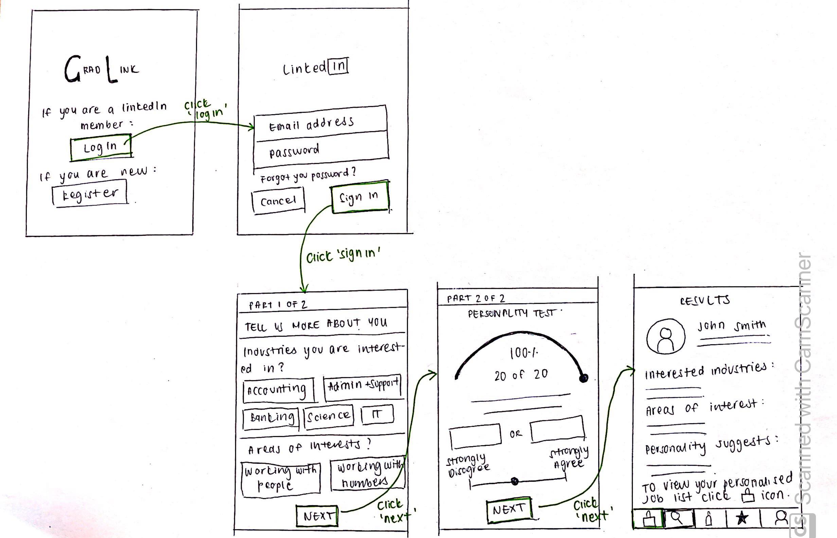
Solution Sketch 1
Upload a photo of your sketch on this slide
Auto Recommendation

Slide 19
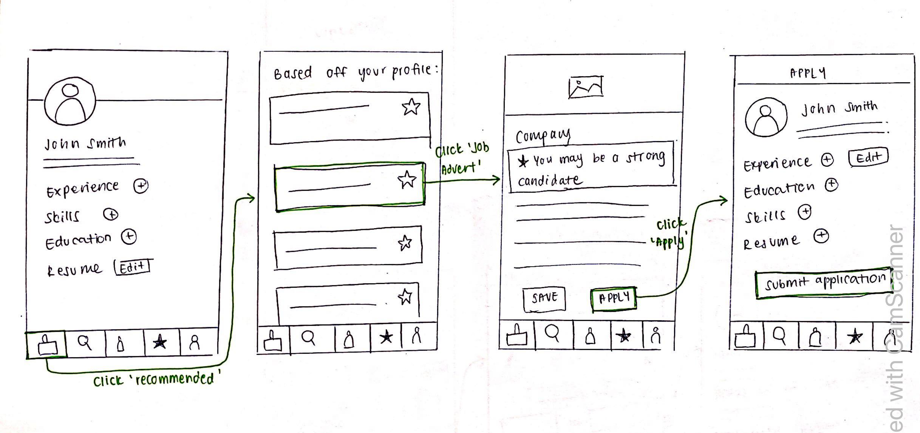
Solution Sketch 2
Upload a photo of your sketch on this slide
Job Application

Slide 20
Decide
Pick the final concept that you develop into a prototype
Notes:
[ALL PARTICIPATION]

Slide 21
Decision
Decision | Auto Recommendation
Rationale | Our aim is to create a tool that will recommend the best jobs to recent college graduates based on their skills and preferences hence why the auto recommendation feature has been chosen. It is high effort to build however offers high value for users who are looking for a personalised service. Currently, there are only a handful of companies that offer career education, guidance and placement opportunities for graduates. The feature will cover both the guidance and placement aspects of the app and will put us ahead of traditional job search engines that do not offer personalisation.

Slide 22
Prototype
Turn your concept into a realistic, interactive prototype that you will use to validate your assumptions and ideas
Notes:
[ALL PARTICIPATION]

Slide 23
Pick the best and create a storyboard
REFERENCE
REMOVE BEFORE SUBMITTING
Turn your best solution sketch into a storyboard. We’ll then use the storyboard as the blueprint to create the prototype.
The storyboard should:
Be high fidelity enough to build a prototype with at least three screens:
Detail the steps a user goes through and how they progress from one step to the next
Detail the layout of the software experience (wireframe level detail)
Should cover the entire user journey (ie: things that can happen outside the software experience)
What prompts the user to use this?
You can create a storyboard using ThePlot.io or use the template on the following pages

Slide 24
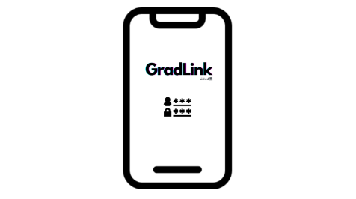
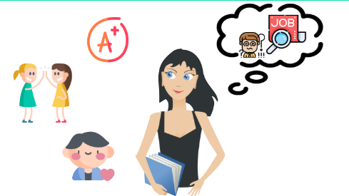

Storyboard
Rachel is a month away from finishing her Bachelors Degree in Finance. She has everything figured out in life, good grades, great friends, hot boyfriend. The only thing she does not have is a job. She has been putting off her job hunt for months because she has no idea what she wants to do. | One day, Rachel meets Sam for a quick coffee catch up before class. She tells Sam about her troubles. Sam advises that he has recently found an app that he thinks might help solve Rachel's problems. He forwards her the link to download the Gradink app. | Rachel downloads the app and signs in with her existing LinkedIn details. To her surprise, her details with LinkedIn are automatically synced with the app and she does not need to fill anything in.

Slide 25
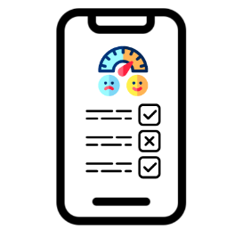
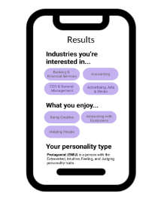
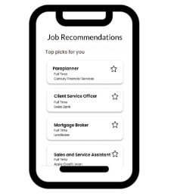
Storyboard
Rachel then goes on the complete the self assessment, listing her interests, preferences, goals and also taking a personality test to learn more about herself. The questions are quick, short and fun to complete. | Rachel is then given her results. The page summarizes her interests, preferences, goals and a detailed explanation of her personality type. She finds out that she is a Protagonist (ENFJ) and finds fulfilment in doing what she love most – helping other people. | Rachel then goes on the view her recommended jobs. All the roles gravitate toward careers with an altruistic bent and are highly relevant to her finance degree.

Slide 26
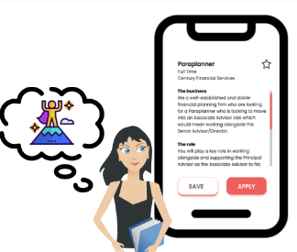
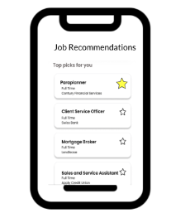
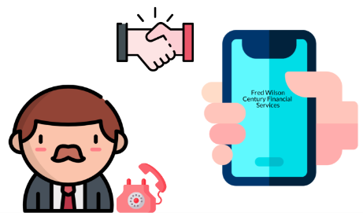
Storyboard
Finally figuring out her passion, Rachel feels empowered to help people improve their financial position with the knowledge she has learnt. She finds paraplanning role for a financial adviser and clicks apply. | Rachel has finally taken her first steps towards landing a job. Now she knows what she wants to do, it's easy for her to hop on the app and apply for any new job listings that come up. | Rachel receives a call a few days later with an invitation to come into the office and meet the team. She is quickly offered a job.

Slide 27


Storyboard
Rachel now has everything figured out in life, good grades, great friends, hot boyfriend, amazing job, and the greatest thing is that she has finally found her passion!

Slide 28

Prototype
Description High level overview of the prototype What does it do? | User is asked to login with existing LinkedIn details. The user is then asked to complete a self assessment. Afterwards, the user is provided with assessment results and job recommendations. The user can select which job they prefer. The are then able to apply for the job. User is also able to edit their existing LinkedIn profile.
Assumptions Any assumptions within the prototype | User is a member of LinkedIn and has log in details User will fill out self assessment User logs in for first time and profile is automatically created
Tasks What are the tasks that a user can complete in the prototype? | Sign up and sign in Self Assessment about fields of interest and personality type View auto recommended jobs Apply for jobs Edit profile and personal contact details Upload Resume
Link your prototype

Slide 29
Validate
Users will go through your prototype and provide feedback on your concept. This is also an opportunity to have an engineering feasibility discussion
Notes:
[ALL PARTICIPATION]

Slide 30
GradLink Research Plan
PM: Vanessa Lam
STATUS: DRAFT
Research Plan

Slide 31

User Testing: Participant 1 Key Findings
What worked well | Structure and general UX concept is simple and clean. The user found it easy to navigate and had a clean workflow User found self assessment easy to complete and did not have an issue with the retake quiz mechanism. No problems with finding recommended jobs and applying for a job User easily found profile Overall: User could complete the tasks without knowledge. User found the feature useful.
Where participants got stuck | Result page scroll function did not work Result page ‘Next/ View Recommended Job’ button rather than text would be beneficial
Other observations | Confusion when selecting industry and interest preferences due to prototype reasons User confirms they would use the auto job recommendation feature

Slide 32
User Testing: Participant 2 Key Findings
What worked well | Navigation was clear for user. Quick to apply for an application, useful personality information. User found it easy to log in as an existing LinkedIn user User did enjoy the self assessment No issues navigating to the recommended jobs page. No issues applying for a job No issues locating the profile
Where participants got stuck | Self assessment results page should have a edit function. User suggested search function for self assessment when looking for industry and interests. Instead of person icon on navigation bar, replace with profile picture
Other observations | User found it easy to apply for a job Navigation via bottom navigation bar was easy. No issues observed

Slide 33
Handoff
© 2019 Udacity. All rights reserved.
Notes:
[ALL PARTICIPATION]

Slide 34
Updated PRD
Updated PRD

